Slide 1
WE SECURE
THE POWER
BEFORE THE LAND
Powered land for data centers and heavy industry, developed from the substation outward.
INVESTOR BRIEFING · Q4 2026 · CONFIDENTIAL
Notes:
Title layout. Three short lines, uppercase. The background is the brand terrain: gridlines and contours with one amber node. Swap in site photography, treated dark, when it exists.

Slide 2
HOW TO USE THIS TEMPLATE
READ FIRST · DELETE BEFORE PRESENTING
New slide: Home > New Slide, then pick a layout. Every layout comes in Dark and Light.
Blank versions of every layout sit at the end of this file. Duplicate what you need, then delete the examples.
Click a placeholder and type. Sizes, colors and spacing are built in.
Install the fonts first: Archivo, IBM Plex Sans and IBM Plex Mono, free on Google Fonts. Without them, line breaks move.
One amber thing per slide. Headlines in uppercase, body in sentence case.
Figures, names and contact details in the examples are placeholders. Replace them before use.
IN THIS FILE
01 Start here
02 Examples · Dark
03 Examples · Light
04 Blank layouts · Dark
05 Blank layouts · Light
Notes:
Instructions for whoever builds decks from this file. Delete this slide before presenting.

Slide 3
WHY POWER COMES FIRST
01

Slide 4
FOUR TOPICS, IN THE ORDER WE DO THE WORK
AGENDA
01 Why power comes first
02 Our approach: site, power, land, community
03 Pipeline and markets
04 Team and next steps

Slide 5

THE GRID IS THE BOTTLENECK. WE PLAN FOR IT FIRST.
THE THESIS
Most large-load sites fail on power, not land. Available capacity, queue position and upgrade cost decide whether a site can be delivered, and when.
We begin with the utility: capacity at the substation, the interconnection queue, and the cost and schedule of upgrades.
Only then do we assemble acreage, working outward from the point of interconnection.
Entitlements and community agreements are secured before a site is offered to a user.
POINT OF INTERCONNECTION

Slide 6
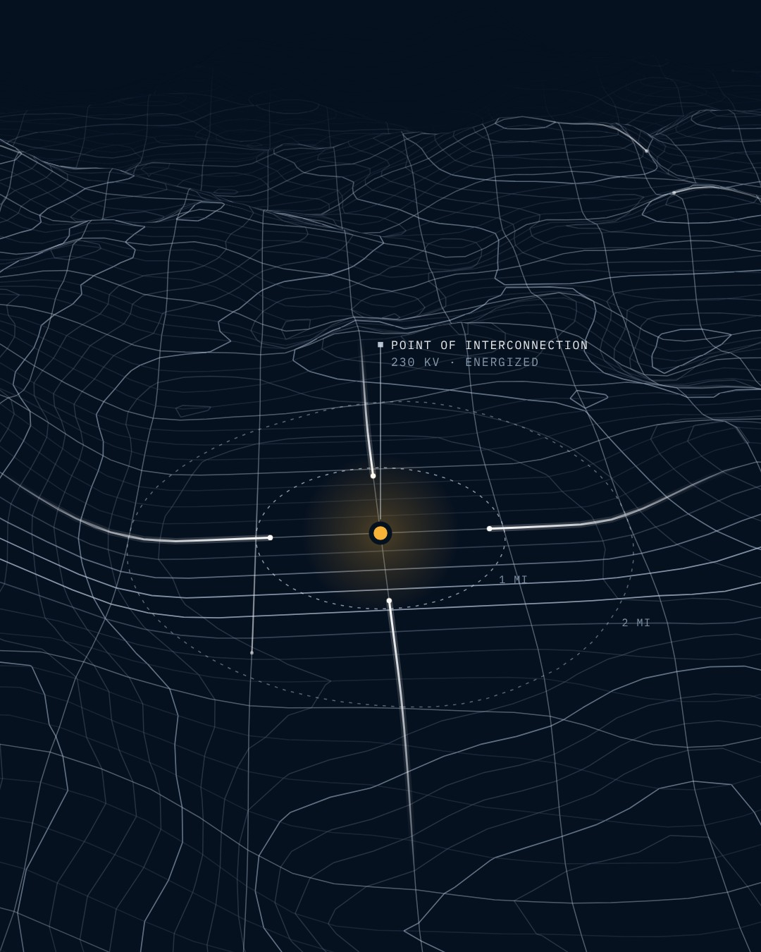
START AT THE SUBSTATION. WORK OUTWARD.
02 / POWER STRATEGY
We engage the serving utility before we option land. Load studies, queue position and upgrade scope are known quantities when we close.
Pre-application meetings with utility planning
Interconnection request filed with site control
Upgrade cost and schedule tracked to energization

Slide 7

EVERY ACRE HAS A PATH TO POWER
PLACEHOLDER COUNTY, GA · 230 KV · 0.8 MI TO POINT OF INTERCONNECTION
Notes:
Full-bleed image layout. Shown with the brand terrain. For photography: desaturate to 40 percent, then a navy-950 overlay at 55 to 75 percent.

Slide 8
SCALE, STATED PLAINLY
BY THE NUMBERS
6,400+
1,850
3
75+
ACRES UNDER CONTROL
MW UNDER DEVELOPMENT
ACTIVE MARKETS
YEARS COMBINED TEAM EXPERIENCE
Placeholder figures for layout. Grant to replace with verified numbers and an as-of date.

Slide 9
SITE 01: PLACEHOLDER COUNTY, GEORGIA
SITE OVERVIEW
ACREAGE
1,240 ac controlled
POWER
300 MW requested, 230 kV
DISTANCE TO POI
0.8 mi
ZONING
Industrial, by right
STATUS
Interconnection study under way
230 KV · TRANSMISSION
SUBSTATION
SITE 01
CONTROLLED · 1,240 AC
N ↑ 1 MI
Notes:
Map layout. Shapes are native and editable. Keep maps schematic: hairline graticule, blue transmission, green parcels, one amber node for the site.

Slide 10



WE KNOW WHAT THIS WORK TAKES
TEAM
[TITLE]
[TITLE]
GRANT TALLON
JESSE BENTLEY
[Two-line bio. Lead with a fact: years, megawatts, acres.]
[Two-line bio. Lead with a fact: years, megawatts, acres.]
Notes:
Team example: two partners with portraits. Portraits are square, black and white, matched in tone. For four people use the blank Team layout at the end of this file.

Slide 11
FROM FIRST UTILITY MEETING TO POWERED SITE
ROADMAP
MONTH 0
MONTH 3
MONTH 6
MONTH 14
MONTH 24
UTILITY ENGAGEMENT
SITE CONTROL
INTERCONNECTION FILED
ENTITLEMENTS
POWERED SITE
Capacity screen and pre-application meeting.
Options executed around the point of interconnection.
Queue position secured; studies begin.
Zoning, permits and county agreements in place.
Delivered to the user, ready to build.
Illustrative schedule. The amber node marks the current stage.

Slide 12
ACTIVE SITES BY MARKET
PIPELINE
SITE | MARKET | STATUS | ACRES | MW | VOLTAGE
Site 01 | Georgia | Interconnection study | 1,240 | 300 | 230 kV
Site 02 | Georgia | Site control | 860 | 250 | 230 kV
Site 03 | Alabama | Entitlements | 2,100 | 600 | 500 kV
Site 04 | Texas | Utility engagement | 1,450 | 400 | 345 kV
Site 05 | Texas | Interconnection filed | 750 | 300 | 138 kV
Placeholder data for layout. Figures in IBM Plex Mono, right-aligned. Replace before use.

Slide 13
The work done before closing determines everything after it. By the time we buy land, the power question has an answer.
[NAME] · [TITLE], GRIDLINE DEVELOPMENT

Slide 14
READY TO TALK
ABOUT A SITE?
Grant Tallon, [Title]
grant@gridlinedevelopment.com (placeholder)
linkedin.com/company/gridline-development (placeholder)

Slide 15
LIGHT ALTERNATE
FOR PRINT AND
COUNTY MEETINGS
The same layouts on paper. Use when a deck will be printed or projected in a bright room.
INVESTOR BRIEFING · Q4 2026 · CONFIDENTIAL
Notes:
Title layout. Three short lines, uppercase. The background is the brand terrain: gridlines and contours with one amber node. Swap in site photography, treated dark, when it exists.

Slide 16
OUR APPROACH
02

Slide 17
FOUR TOPICS, IN THE ORDER WE DO THE WORK
AGENDA
01 Why power comes first
02 Our approach: site, power, land, community
03 Pipeline and markets
04 Team and next steps

Slide 18
THE GRID IS THE BOTTLENECK. WE PLAN FOR IT FIRST.
THE THESIS
Most large-load sites fail on power, not land. Available capacity, queue position and upgrade cost decide whether a site can be delivered, and when.
We begin with the utility: capacity at the substation, the interconnection queue, and the cost and schedule of upgrades.
Only then do we assemble acreage, working outward from the point of interconnection.
Entitlements and community agreements are secured before a site is offered to a user.
POINT OF INTERCONNECTION

Slide 19
START AT THE SUBSTATION. WORK OUTWARD.
02 / POWER STRATEGY
We engage the serving utility before we option land. Load studies, queue position and upgrade scope are known quantities when we close.
Pre-application meetings with utility planning
Interconnection request filed with site control
Upgrade cost and schedule tracked to energization

Slide 20
SCALE, STATED PLAINLY
BY THE NUMBERS
6,400+
1,850
3
75+
ACRES UNDER CONTROL
MW UNDER DEVELOPMENT
ACTIVE MARKETS
YEARS COMBINED TEAM EXPERIENCE
Placeholder figures for layout. Grant to replace with verified numbers and an as-of date.

Slide 21
SITE 01: PLACEHOLDER COUNTY, GEORGIA
SITE OVERVIEW
ACREAGE
1,240 ac controlled
POWER
300 MW requested, 230 kV
DISTANCE TO POI
0.8 mi
ZONING
Industrial, by right
STATUS
Interconnection study under way
230 KV · TRANSMISSION
SUBSTATION
SITE 01
CONTROLLED · 1,240 AC
N ↑ 1 MI
Notes:
Map layout. Shapes are native and editable. Keep maps schematic: hairline graticule, blue transmission, green parcels, one amber node for the site.

Slide 22

WE KNOW WHAT THIS WORK TAKES
TEAM
[TITLE]
[TITLE]
GRANT TALLON
JESSE BENTLEY
[Two-line bio. Lead with a fact: years, megawatts, acres.]
[Two-line bio. Lead with a fact: years, megawatts, acres.]
Notes:
Team example: two partners with portraits. Portraits are square, black and white, matched in tone. For four people use the blank Team layout at the end of this file.

Slide 23
FROM FIRST UTILITY MEETING TO POWERED SITE
ROADMAP
MONTH 0
MONTH 3
MONTH 6
MONTH 14
MONTH 24
UTILITY ENGAGEMENT
SITE CONTROL
INTERCONNECTION FILED
ENTITLEMENTS
POWERED SITE
Capacity screen and pre-application meeting.
Options executed around the point of interconnection.
Queue position secured; studies begin.
Zoning, permits and county agreements in place.
Delivered to the user, ready to build.
Illustrative schedule. The amber node marks the current stage.

Slide 24
ACTIVE SITES BY MARKET
PIPELINE
SITE | MARKET | STATUS | ACRES | MW | VOLTAGE
Site 01 | Georgia | Interconnection study | 1,240 | 300 | 230 kV
Site 02 | Georgia | Site control | 860 | 250 | 230 kV
Site 03 | Alabama | Entitlements | 2,100 | 600 | 500 kV
Site 04 | Texas | Utility engagement | 1,450 | 400 | 345 kV
Site 05 | Texas | Interconnection filed | 750 | 300 | 138 kV
Placeholder data for layout. Figures in IBM Plex Mono, right-aligned. Replace before use.

Slide 25
The work done before closing determines everything after it. By the time we buy land, the power question has an answer.
[NAME] · [TITLE], GRIDLINE DEVELOPMENT

Slide 26
Notes:
Blank Title layout, dark theme. Click a placeholder and type: the styles are built in. To add another, use Home > New Slide > "Title · Dark". Three short lines, uppercase.

Slide 27
Notes:
Blank Section divider layout, dark theme. Click a placeholder and type: the styles are built in. To add another, use Home > New Slide > "Section divider · Dark". Two-digit number above, title in uppercase.

Slide 28
01 [Agenda item]
02 [Agenda item]
03 [Agenda item]
04 [Agenda item]
Notes:
Blank Agenda layout, dark theme. Click a placeholder and type: the styles are built in. To add another, use Home > New Slide > "Agenda · Dark". Four to six items. Numbers are IBM Plex Mono.

Slide 29
Notes:
Blank One column layout, dark theme. Click a placeholder and type: the styles are built in. To add another, use Home > New Slide > "One column · Dark". Keep body copy to about 64 characters a line. The right third is free for one diagram.

Slide 30
Notes:
Blank Text and image layout, dark theme. Click a placeholder and type: the styles are built in. To add another, use Home > New Slide > "Text and image · Dark". Click the icon in the right half to place a picture. Treat photography dark.

Slide 31
Notes:
Blank Full-bleed image layout, dark theme. Click a placeholder and type: the styles are built in. To add another, use Home > New Slide > "Full-bleed image · Dark". Place the picture first, then send it to the back. Add a navy band under the caption if the image is light there.

Slide 32
Notes:
Blank Stats layout, dark theme. Click a placeholder and type: the styles are built in. To add another, use Home > New Slide > "Stats · Dark". Four figures at most. Put units in the label when the figure would wrap.

Slide 33
MAP KIT · COPY THESE SHAPES, THEN DELETE THE KIT
ACREAGE
[0,000 ac controlled]
POWER
[000 MW requested, 000 kV]
DISTANCE TO POI
[0.0 mi]
ZONING
[Zoning status]
STATUS
[Current stage]
TRANSMISSION · 000 KV
CONTROLLED · 0,000 AC
SUBSTATION
SITE 00 · ONE PER MAP
N ↑ 1 MI
Notes:
Map layout. Shapes are native and editable. Keep maps schematic: hairline graticule, blue transmission, green parcels, one amber node for the site.

Slide 34
PORTRAIT
PORTRAIT
PORTRAIT
PORTRAIT
[NAME]
[NAME]
[NAME]
[NAME]
[ROLE, FOUR WORDS MAX]
[ROLE, FOUR WORDS MAX]
[ROLE, FOUR WORDS MAX]
[ROLE, FOUR WORDS MAX]
[Two-line bio. Lead with a fact: years, megawatts, acres.]
[Two-line bio. Lead with a fact: years, megawatts, acres.]
[Two-line bio. Lead with a fact: years, megawatts, acres.]
[Two-line bio. Lead with a fact: years, megawatts, acres.]
Notes:
Portraits: place a photo over each PORTRAIT frame, crop to the frame, keep it black and white. Four people a slide; add a second slide rather than a second row.

Slide 35
MONTH 00
MONTH 00
MONTH 00
MONTH 00
MONTH 00
[STAGE]
[STAGE]
[STAGE]
[STAGE]
[STAGE]
[One line on what happens at this stage.]
[One line on what happens at this stage.]
[One line on what happens at this stage.]
[One line on what happens at this stage.]
[One line on what happens at this stage.]
The amber node marks the current stage. Move it, and keep only one.
Notes:
Blank Timeline layout, dark theme. Click a placeholder and type: the styles are built in. To add another, use Home > New Slide > "Timeline · Dark". Five stages fit. The amber node marks where a site is today.

Slide 36
LABEL | LABEL | LABEL | FIGURE | FIGURE | FIGURE
[Text] | [Text] | [Text] | 0,000 | 000 | 000
[Text] | [Text] | [Text] | 0,000 | 000 | 000
[Text] | [Text] | [Text] | 0,000 | 000 | 000
[Text] | [Text] | [Text] | 0,000 | 000 | 000
[Text] | [Text] | [Text] | 0,000 | 000 | 000
Notes:
Table: text columns left in IBM Plex Sans, figures right in IBM Plex Mono. Six columns and seven rows is the ceiling; split a bigger table over two slides.

Slide 37
Notes:
Blank Quote layout, dark theme. Click a placeholder and type: the styles are built in. To add another, use Home > New Slide > "Quote · Dark". One or two sentences. Attribution in uppercase: name, title, organization.

Slide 38
Notes:
Blank Closing layout, dark theme. Click a placeholder and type: the styles are built in. To add another, use Home > New Slide > "Closing · Dark". One question or one line. Contact details below.

Slide 39
Notes:
Blank Blank layout, dark theme. Click a placeholder and type: the styles are built in. To add another, use Home > New Slide > "Blank · Dark". Footer and corner grid only. Build on the 0.5 inch grid and keep 0.75 inch margins.

Slide 40
Notes:
Blank Title layout, light theme. Click a placeholder and type: the styles are built in. To add another, use Home > New Slide > "Title · Light". Three short lines, uppercase.

Slide 41
Notes:
Blank Section divider layout, light theme. Click a placeholder and type: the styles are built in. To add another, use Home > New Slide > "Section divider · Light". Two-digit number above, title in uppercase.

Slide 42
01 [Agenda item]
02 [Agenda item]
03 [Agenda item]
04 [Agenda item]
Notes:
Blank Agenda layout, light theme. Click a placeholder and type: the styles are built in. To add another, use Home > New Slide > "Agenda · Light". Four to six items. Numbers are IBM Plex Mono.

Slide 43
Notes:
Blank One column layout, light theme. Click a placeholder and type: the styles are built in. To add another, use Home > New Slide > "One column · Light". Keep body copy to about 64 characters a line. The right third is free for one diagram.

Slide 44
Notes:
Blank Text and image layout, light theme. Click a placeholder and type: the styles are built in. To add another, use Home > New Slide > "Text and image · Light". Click the icon in the right half to place a picture. Treat photography dark.

Slide 45
Notes:
Blank Stats layout, light theme. Click a placeholder and type: the styles are built in. To add another, use Home > New Slide > "Stats · Light". Four figures at most. Put units in the label when the figure would wrap.

Slide 46
MAP KIT · COPY THESE SHAPES, THEN DELETE THE KIT
ACREAGE
[0,000 ac controlled]
POWER
[000 MW requested, 000 kV]
DISTANCE TO POI
[0.0 mi]
ZONING
[Zoning status]
STATUS
[Current stage]
TRANSMISSION · 000 KV
CONTROLLED · 0,000 AC
SUBSTATION
SITE 00 · ONE PER MAP
N ↑ 1 MI
Notes:
Map layout. Shapes are native and editable. Keep maps schematic: hairline graticule, blue transmission, green parcels, one amber node for the site.

Slide 47
PORTRAIT
PORTRAIT
PORTRAIT
PORTRAIT
[NAME]
[NAME]
[NAME]
[NAME]
[ROLE, FOUR WORDS MAX]
[ROLE, FOUR WORDS MAX]
[ROLE, FOUR WORDS MAX]
[ROLE, FOUR WORDS MAX]
[Two-line bio. Lead with a fact: years, megawatts, acres.]
[Two-line bio. Lead with a fact: years, megawatts, acres.]
[Two-line bio. Lead with a fact: years, megawatts, acres.]
[Two-line bio. Lead with a fact: years, megawatts, acres.]
Notes:
Portraits: place a photo over each PORTRAIT frame, crop to the frame, keep it black and white. Four people a slide; add a second slide rather than a second row.

Slide 48
MONTH 00
MONTH 00
MONTH 00
MONTH 00
MONTH 00
[STAGE]
[STAGE]
[STAGE]
[STAGE]
[STAGE]
[One line on what happens at this stage.]
[One line on what happens at this stage.]
[One line on what happens at this stage.]
[One line on what happens at this stage.]
[One line on what happens at this stage.]
The amber node marks the current stage. Move it, and keep only one.
Notes:
Blank Timeline layout, light theme. Click a placeholder and type: the styles are built in. To add another, use Home > New Slide > "Timeline · Light". Five stages fit. The amber node marks where a site is today.

Slide 49
LABEL | LABEL | LABEL | FIGURE | FIGURE | FIGURE
[Text] | [Text] | [Text] | 0,000 | 000 | 000
[Text] | [Text] | [Text] | 0,000 | 000 | 000
[Text] | [Text] | [Text] | 0,000 | 000 | 000
[Text] | [Text] | [Text] | 0,000 | 000 | 000
[Text] | [Text] | [Text] | 0,000 | 000 | 000
Notes:
Table: text columns left in IBM Plex Sans, figures right in IBM Plex Mono. Six columns and seven rows is the ceiling; split a bigger table over two slides.

Slide 50
Notes:
Blank Quote layout, light theme. Click a placeholder and type: the styles are built in. To add another, use Home > New Slide > "Quote · Light". One or two sentences. Attribution in uppercase: name, title, organization.

Slide 51
Notes:
Blank Blank layout, light theme. Click a placeholder and type: the styles are built in. To add another, use Home > New Slide > "Blank · Light". Footer and corner grid only. Build on the 0.5 inch grid and keep 0.75 inch margins.

